Slide 1
Apache Spark

Slide 2
Types of Big Data Analytics
Batch Analytics
Real Time Analytics

Slide 3
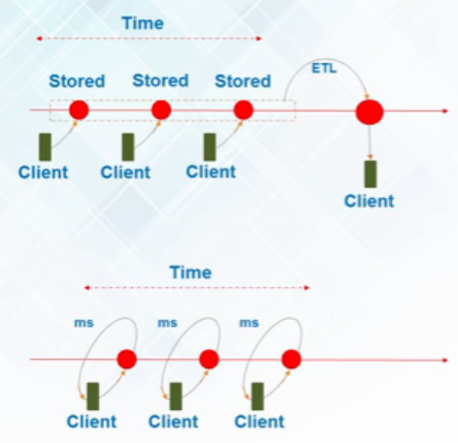
Batch vs Real Time Analytics
Analytics based on data collected over a period of time is Batch Analytics. e.g. Washing machine example
Analytics based on real time time data for instant result is Real Time Analytics/Stream Analytics. E.g. credit card example

Slide 4

Use cases of Real Time Analytics

Slide 5
Why Spark when Hadoop is already there?

Slide 6
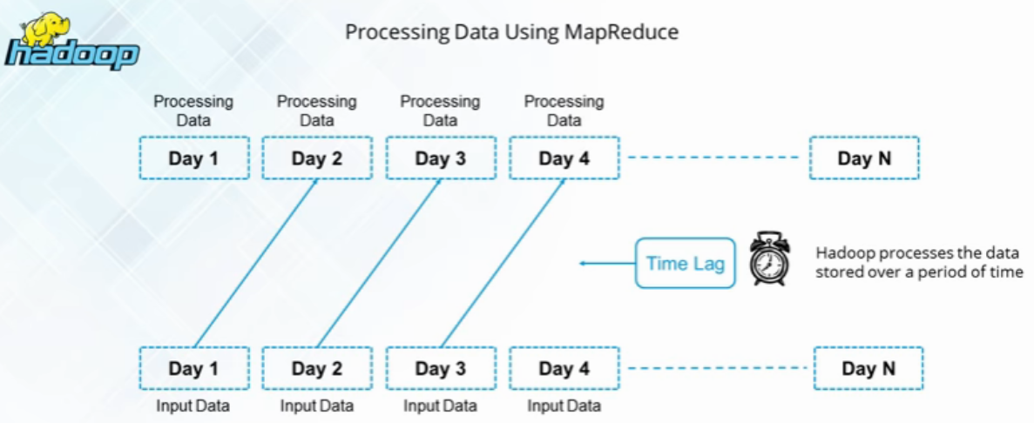
Batch Processing in Hadoop

Slide 7
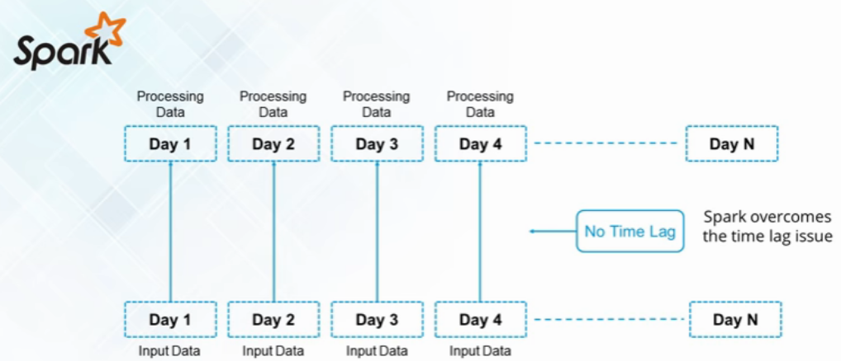
Real Time Processing in Spark

Slide 8
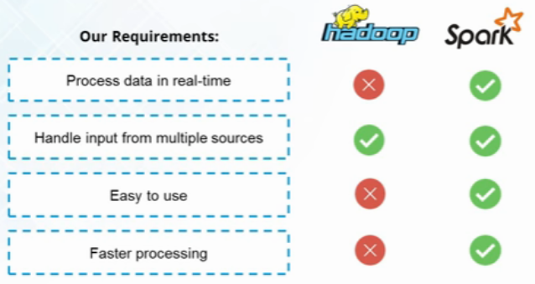
Spark vs Hadoop
Hadoop implements Batch processing on big data and thus cannot deliver to Real Time use case needs.

Slide 9
Example

Slide 10

Spark Success Story

Slide 11
Spark Overview

Slide 12

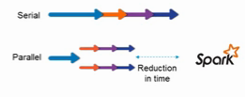
What is Apache Spark?
Apache Spark is an open-source cluster-computing framework for real time processing by Apache Software Foundation
Spark provides an interface for programming entire clusters with implicit data parallelism and fault-tolerance
It was built on top of Hadoop MapReduce and it extends the MapReduce model to efficiently use more types of computations

Slide 13
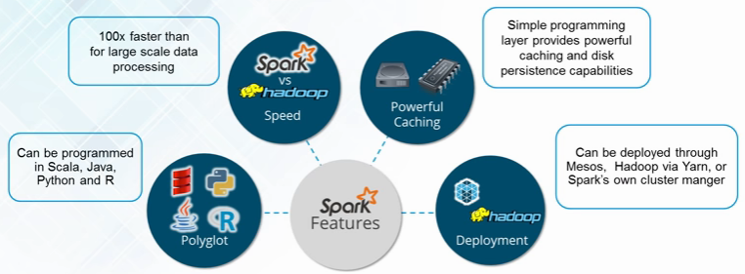
Why Spark?

Slide 14
Using Hadoop Through Spark

Slide 15
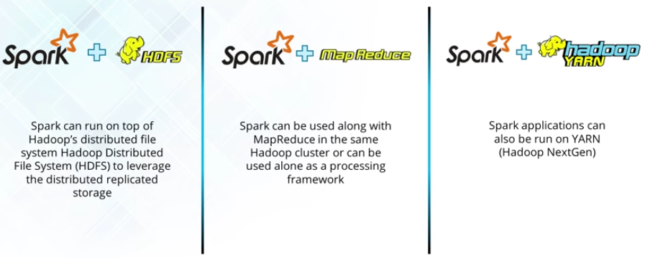
Spark and Hadoop

Slide 16
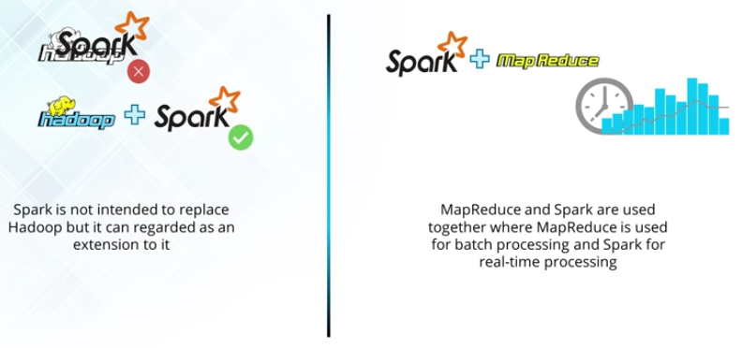
Spark and Hadoop

Slide 17
Spark Features
Speed
Polyglot
Advanced Analytics
In-Memory Computation
Hadoop Integration
Machine Learning

Slide 18
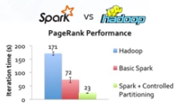

Spark Features
Spark runs up to 100x times faster than MapReduce.
Polyglot: Programming in Scala, Python, Java and R

Slide 19

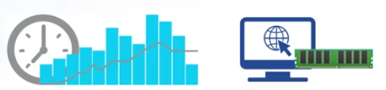
Spark Features
Lazy Evaluation: Delays evaluation till needed
Real time computation & low latency because of in-memory computation

Slide 20


Spark Features
Hadoop Integration
Machine Learning for iterative tasks

Slide 21
Spark Ecosystem
Spark Core
Spark SQL
Spark Streaming
MLlib
GraphX
Spark R

Slide 22
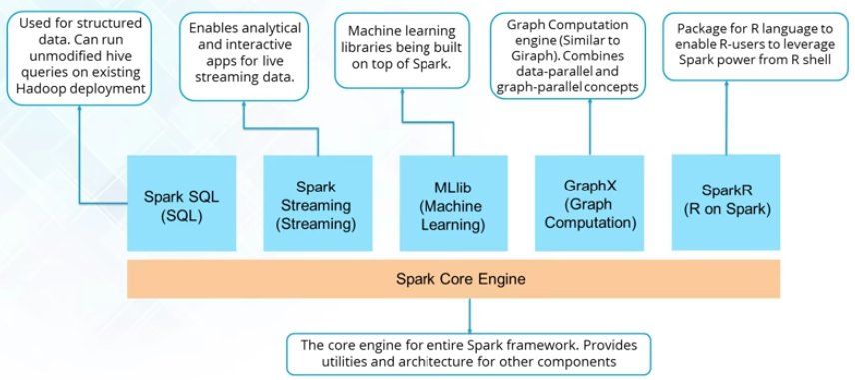
Spark Ecosystem

Slide 23
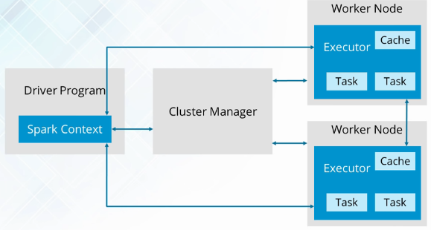
Spark Architecture

Slide 24
SparkContext
SparkContext is the entry gate of Apache Spark functionality.
The most important step of any Spark driver application is to generate SparkContext. It allows Spark Application to access Spark Cluster with the help of Resource Manager (YARN/Mesos).
To create SparkContext, first SparkConf should be made.
The SparkConf has a configuration parameter that our Spark driver application will pass to SparkContext.

Slide 25
SparkContext
After the creation of a SparkContext object, we can invoke functions such as textFile, sequenceFile, parallelize etc.
It can also be used to create RDDs, broadcast variable, and accumulator, ingress Spark service and run jobs.
All these things can be carried out until SparkContext is stopped.
Only one SparkContext may be active per JVM.
It must be stopped before creating a new one as below: stop(): Unit It will display the following message: INFO SparkContext: Successfully stopped SparkContext

Slide 26
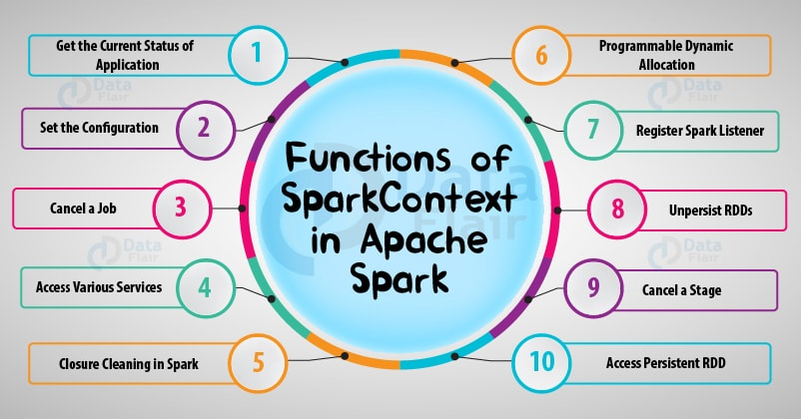

Slide 27
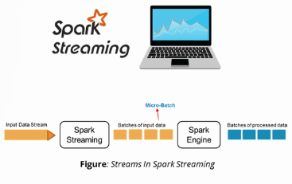
Spark Streaming
Spark Streaming is used for processing real-time streaming data
It is useful addition to the core Spark API
Spark Streaming enables high-throughput and fault-tolerant stream processing of live data streams
The fundamental stream unit is DStream which is basically a series of RDDs to process the real-time data

Slide 28
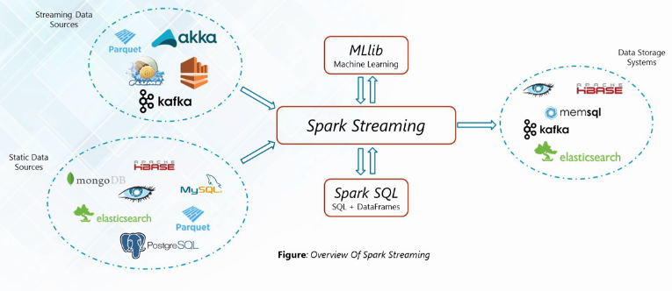
Spark Streaming

Slide 29
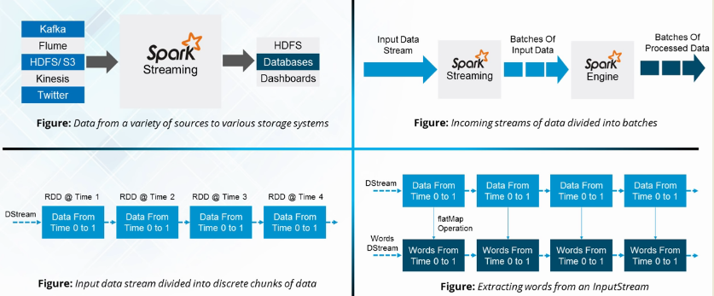
Spark Streaming

Slide 30
Spark SQL

Slide 31
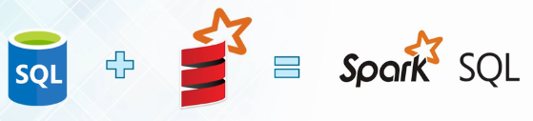

Spark SQL Features
Spark SQL integrates relational processing with Spark’s fundamental programming
Spark SQL is used for the structured/semi structured data analysis in Spark

Slide 32

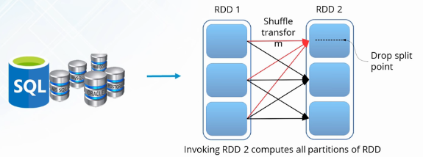
Spark SQL Features
Support for various data formats
SQL queries can be converted into RDDs for transformations

Slide 33
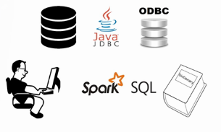
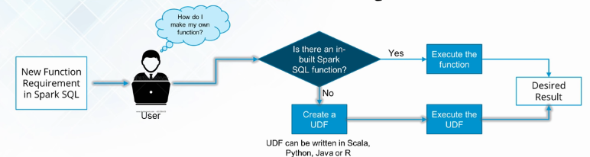
Spark SQL Features
Standard JDBC/ODBC Connectivity
User Defined Functions lets user define new Column-based functions to extend the Spark vocabulary

Slide 34
Why Spark when Hadoop is already there?

Slide 35
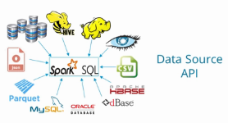
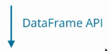
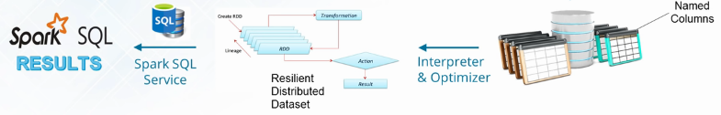
Spark SQL Flow Diagram
Spark SQL has the following libraries:
Data Source API
DataFrame API
Interpreter & Optimizer
SQL Service
The flow diagram represents a Spark SQL process using all the four libraries in sequence

Slide 36
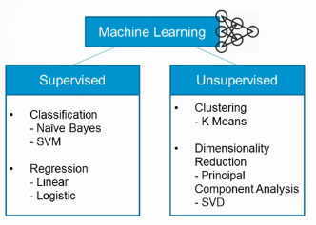
MLlib
Machine learning can be broken down into two classes of algorithms:
Supervised algorithms use labeled data
Unsupervised algorithms make sense of the data without labels

Slide 37

MLlib Techniques
Three common categories of techniques:
Classification
Clustering
Collaborative Filtering

Slide 38
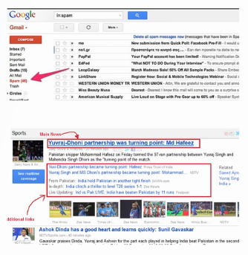
Mllib - Techniques
Classification: It is family of supervised machine learning algorithms that designate input as belonging to one of several pre-defined classes
Some common use cases for classification include: Credit Card fraud detection, Email spam detection
Clustering: In clustering, an algorithm groups objects into categories by analyzing similarities between input examples

Slide 39

Mllib - Techniques
Collaborative Filtering: These algorithms recommend items(filtering) based on preference information from many users(collaborative)

Slide 40
GraphX

Slide 41
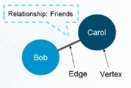
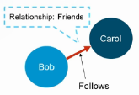
GraphX
A graph is a mathematical structure used to model relations between objects. A graph is made up of vertices and edges that connect them. The vertices are the objects and the edges are the relationships between them.
A directed graph is a graph where the edges have a direction associated with them. E.g. User Bob follows Carol on Facebook.

Slide 42
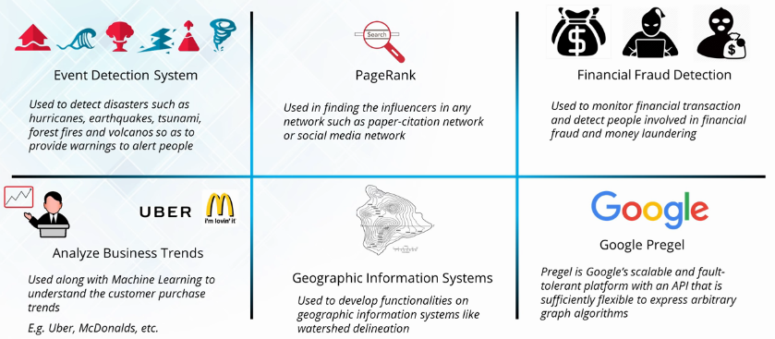
GraphX Use Cases

Slide 43
Use Case: Earthquack Detection using Spark

Slide 44
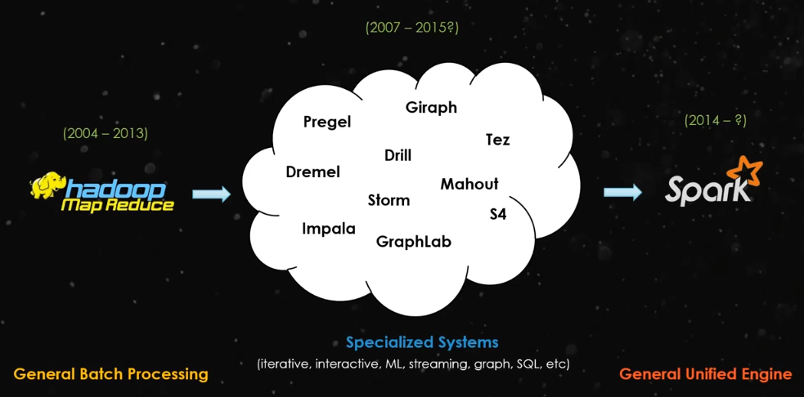
Why Spark became popular?

Slide 45
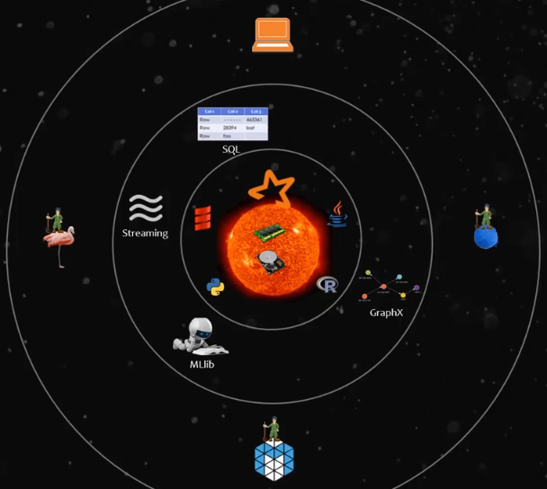

Slide 46
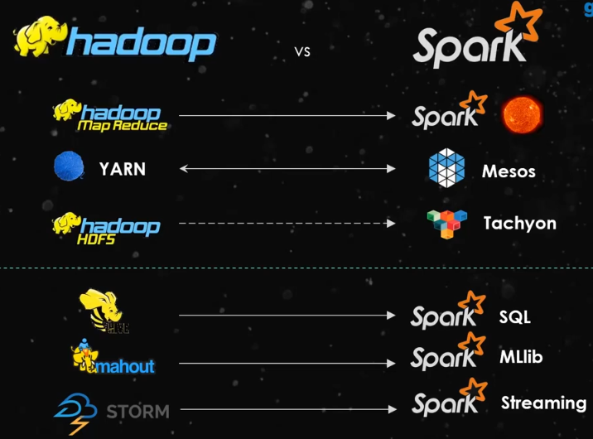

Slide 47
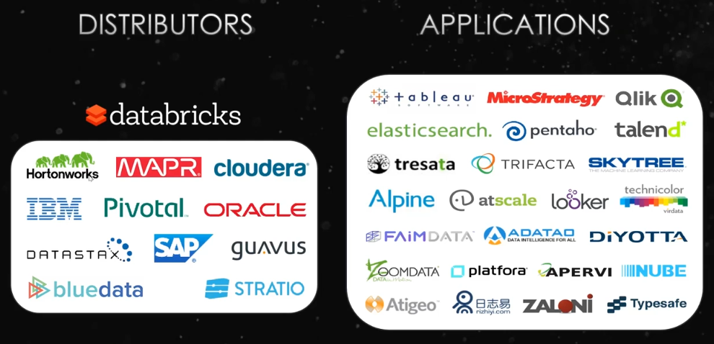

Slide 48
Spark Processing in cluster
Assume,
Cluster of five nodes 1,2,3,4,5.
10 GB file stored on Hadoop. Divided in three parts and available at node 2,3,4 and 5.
Spark programs asks for 4 executors each of 5 GB memory and 2 cores
Driver starts at Node 1
Node 2,3,4,5 selected to run these executors
Size of these executors has to be specified in spark program

Slide 49
Size of Executor
We cannot ask for one executor of 100 GB RAM and 100 cores!
Also, asking for one executor of 20 GB RAM and 8 cores is not good. It is similar to executing in single local machine.
Appropriate size of executors should be demanded in code. Generally, this decision is taken after discussing with admin. E.g. 4 executors of 5 GB RAM and 2 cores each.
This would increase parallelism.

Slide 50
MapReduce
Spark
Mappers are always launched on nodes where data is available
No. of mappers = no. of blocks
When executors are launched, there is no guarantee that they will be launched on same machines where data is available as YARN does not know anything about data locality.
Executors might be launched on same machines or different machines, so initially it might take some time to fetch data in memory, but even then it would be faster than MapReduce.
Number of executors and its size has to be decided while writing spark program.

Slide 51
MapReduce Block
Spark Partition
One or more blocks will be processed by mappers.
Size of each block is 128 MB.
Blocks are stored on disk.
One or more partitions will be processed by executors.
Each block becomes one partition in spark.
While using other data storage, data has to be divided into partitions first. Normally, spark tries to set the number of partitions automatically based on cluster.
More partitions results in more parallelism.
Partitions are stored in RAM

Slide 52
Executor Memory Utilization
If 10 GB executor is launched, we cannot use full capacity for data storage.
10 % of memory is allocated to system calls. E.g. from 10 GB capacity, 1 GB is used for system calls.
From remaining 90% of memory, we can utilize only 60% of memory.
Remaining is used by garbage collector, JVM management and all.
So, we can utilize only 54% of full capacity for data storage. e.g., from 10 GB storage, we can utilize only 5.8 GB.
Each executor needs at least one processor core. So, on dual core, only two executors can be launched.

Slide 53
SparkDynamicMemoryUtilization
If set to true, it will go for dynamic memory utilization. It means, if 8 executors are launched, after the work is finished, it will automatically kill idle executors.
If set to false, it will not go for dynamic memory utilization. It means, if 8 executors are launched, after the work is finished, it will still keep them as it is and will not kill idle executors.
Executors can be killed automatically after completing their jobs, but driver has to be stopped. Otherwise even after the job is completed, driver will still be there and eat resources.(e.g. default 1 core and all)

Slide 54
RDD Fundamentals
Spark revolves around the concept of a resilient distributed dataset (RDD), which is a fault-tolerant collection of elements that can be operated on in parallel.
There are two ways to create RDDs:
parallelizing an existing collection in your driver program, or
referencing a dataset in an external storage system, such as a shared filesystem, HDFS, HBase, or any data source offering a Hadoop InputFormat.
RDDs are immutable. If any operation is performed on RDDs, it will create a new RDD.

Slide 55
Parallelized collections
Parallelized collections are created by calling SparkContext’s parallelize method on an existing collection in your driver program.
The elements of the collection are copied to form a distributed dataset that can be operated on in parallel.
E.g.
data = [1, 2, 3, 4, 5]
distData = sc.parallelize(data)

Slide 56
External Datasets
PySpark can create distributed datasets from any storage source supported by Hadoop, including your local file system, HDFS, Cassandra, HBase, Amazon S3, etc.
Spark supports text files, SequenceFiles, and any other Hadoop InputFormat.
Text file RDDs can be created using SparkContext’s textFile method.
This method takes a URI for the file (either a local path on the machine, or a hdfs://, s3a://, etc URI) and reads it as a collection of lines. Here is an example invocation:
distFile = sc.textFile("data.txt")

Slide 57
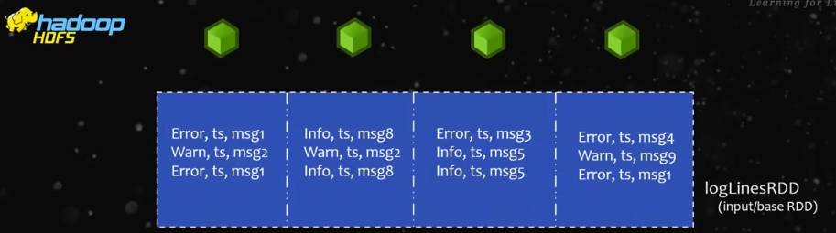
Example - Four executors

Slide 58
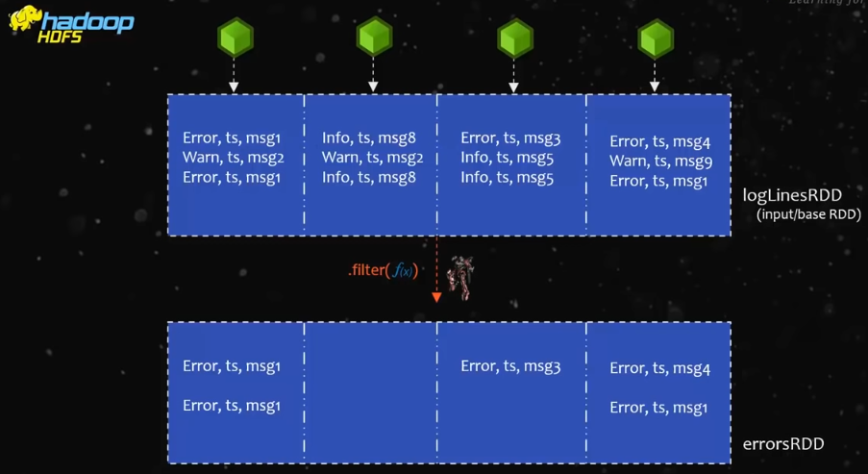
Example - Four executors

Slide 59
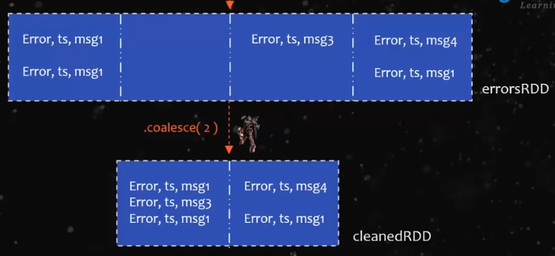
Example - Four executors

Slide 60
Difference between coalesce and repartition
Repartition shuffles full data to reduce partitions, whereas coalesce is more intelligent and does less data movement.
Repartition can also be used to increase number of partitions.
Coalesce cannot be used to increase number of partitions.

Slide 61
RDD Fundamentals
Nothing will happen till now due to lazy evaluation.
The reason is till now all are transformations and no action.
To see the desired result, actions should be used.
To decide which RDD operations should be applied, first sampled data can be used and checked.
In previous example, it can be seen that after applying filter, data reduced by almost 50%. So we can call coalesce() to reduce number of partitions.

Slide 62
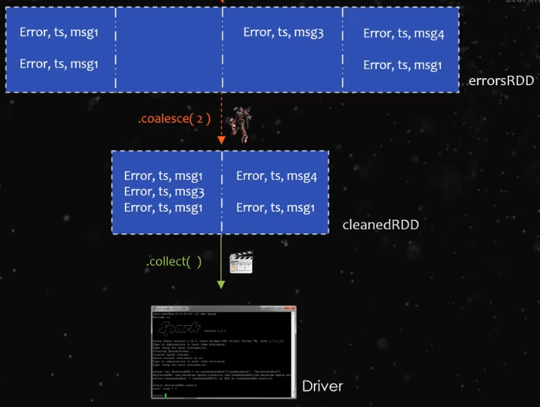

Slide 63
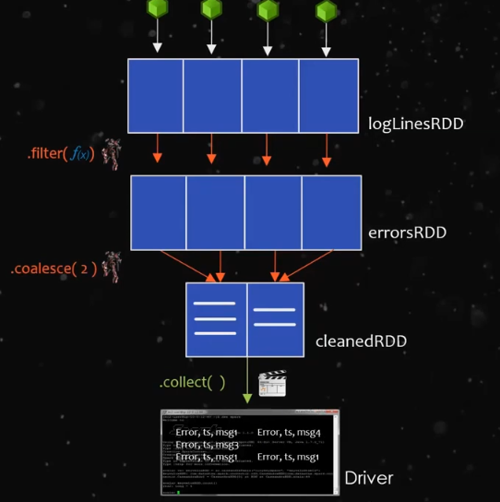

Slide 64
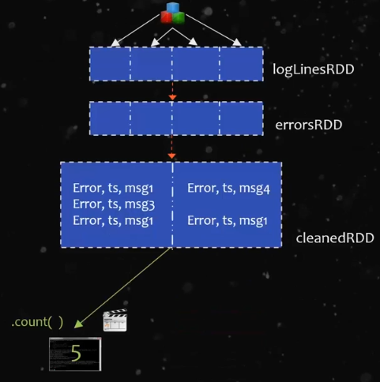

Slide 65
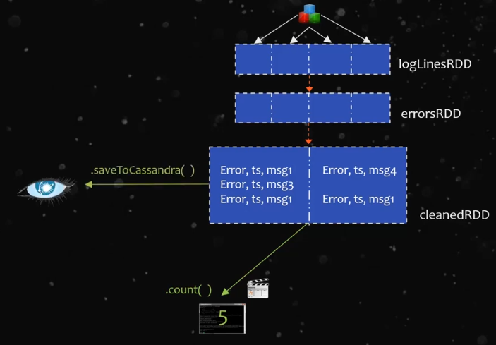

Slide 66
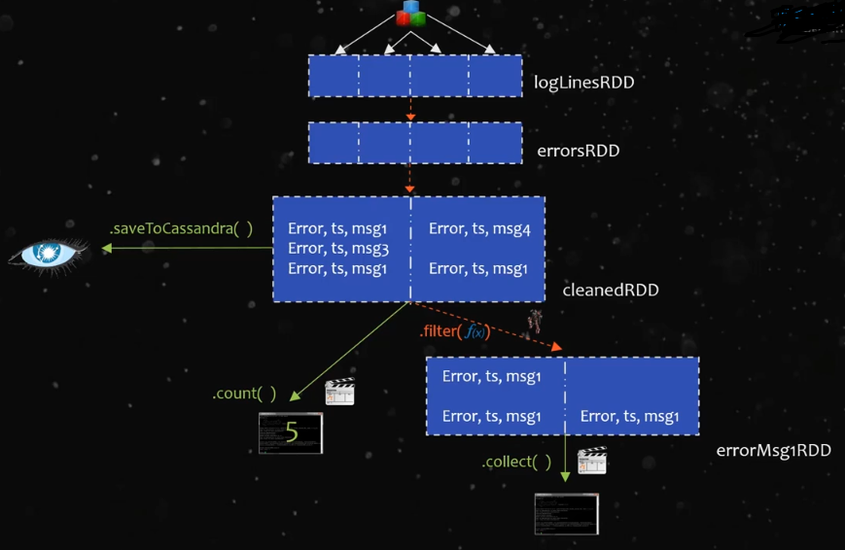

Slide 67
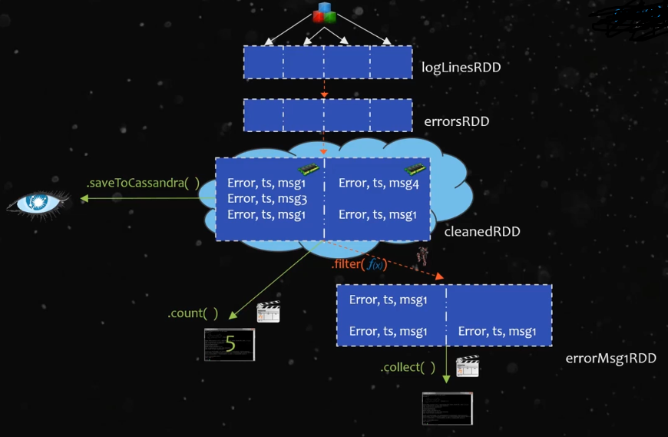

Slide 68
RDD Operations
RDDs support two types of operations:
transformations, which create a new dataset from an existing one, and
actions, which return a value to the driver program after running a computation on the dataset.
For example, map is a transformation that passes each dataset element through a function and returns a new RDD representing the results.
On the other hand, reduce is an action that aggregates all the elements of the RDD using some function and returns the final result to the driver program (although there is also a parallel reduceByKey that returns a distributed dataset).

Slide 69
RDD Operations
All transformations in Spark are lazy, in that they do not compute their results right away. Instead, they just remember the transformations applied to some base dataset (e.g. a file).
The transformations are only computed when an action requires a result to be returned to the driver program. This design enables Spark to run more efficiently.
By default, each transformed RDD may be recomputed each time you run an action on it.
However, you may also persist an RDD in memory using the persist (or cache) method, in which case Spark will keep the elements around on the cluster for much faster access the next time you query it.
There is also support for persisting RDDs on disk, or replicated across multiple nodes.
Caching is useful when calling multiple actions, otherwise it is not very much useful.

Slide 70
Types of transformations
Narrow Transformation
E.g. map,filter
Wide Transformation
E.g. join, groupbykey

Slide 71
Narrow Transformations
These type of transformations can be executed independently on different partitions.
E.g. map(lambda x : (x,1)). This transformation can be executed independently as it has no dependency.
Better performance

Slide 72
Wide Transformations
These type of transformations cannot be executed independently on different partitions.
E.g. groupbykey. This transformation can be executed only after processing the data of all partitions as it has to group data by same key.
Costly operation compared to narrow transformation
Advise: In spark code, more narrow transformations should be used and less wide transformations should be used.

Slide 73
Job in Spark
A parallel computation consisting of multiple tasks that gets spawned in response to a Spark action is called a job.
E.g. a.map then filter then groupbykey. This all together is single job if next operation is some action like count, collect etc.
The jobs are divided into stages depending on how they can be separately carried out (mainly on shuffle boundaries).
Then, these stages are divided into tasks. Tasks are the smallest unit of work that has to be done the executor.

Slide 74
Stages in Spark
A step in a physical execution plan
It is a physical unit of the execution plan.
It is a set of parallel tasks i.e. one task per partition. In other words, each job which gets divided into smaller sets of tasks is a stage.
E.g. map.filter.groupbykey, if this is the sequence of operations in spark, map and filter can execute independently on different partitions, but to execute groupbykey, all executors must finish execution up to filter. Only when all executors finish execution up to filter, groupbykey can be executed. So map and filter forms stage 0 and groupbykey forms stage 1.

Slide 75
References
https://spark.apache.org
https://www.youtube.com/watch?v=9mELEARcxJo
https://www.edureka.co/community/41392/what-are-the-spark-job-and-spark-task-and-spark-staging
https://stackoverflow.com/questions/28973112/what-is-spark-job
https://data-flair.training/blogs/learn-apache-spark-sparkcontext/

